Slide 1
Final year projects for 2023/24
Stanislav Derevyanko, ECE
Notes:
Good time of the day to everyone watching this session online

Slide 2
s-2024-083 Level: Hard Area: Optical communications, nonlinear fiber optics, deep learning Physics Informed Neural Networks for modelling fiber optical signal propagation
Physical channel: A single-channel fiber-optic link with N spans
The nonlinear Schrodinger Equation:
Original
This is PDE! It is solved by split step Fourier method – high complexity digital signal processing!
Many time samples as well as many coordinate samples are needed for high accuracy
The goal: Teach a Deep Neural Network predict the complex dynamics of an optical pulse

Slide 3
Method: Physics informed neural network (PINN)
Input: Coordinate along the fiber and the
time moment
Output: Complex value of the electric field
Loss function: The right hand side of the
propagation equation (NSE).
Uses autodiff feature to compute gradients
Advantage over the black-box DNN: keeps track of the physical model – hence the name PINN!
The accuracy will be compared to the traditional split-step Fourier
References:
[1] X. Jiang et. al., “Physics-Informed Neural Network for Nonlinear Dynamics in Fiber Optics”, Laser Photonics Rev. 16, 2100483 (2022).
[2] G. E. Karniadakis et. al. , “Physics-informed machine learning”, Nat. Rev. Phys. 3, 422, (2021).
[3] S. Wang et. al., “Learning the solution operator of parametric partial differential equations with physics-informed DeepONets”, Sci. Adv. 7, eabi8605 (2021)
Required knowledge:
Optical fibers – 50 %
Deep Learning – 50 %

Slide 4
s-2024-084 Level: Medium Area: Optical communications, nonlinear fiber optics, machine learning Dynamic mode decomposition of the pulse propagation in optical fiber
Physical channel: A single-channel fiber-optic link with N spans
The nonlinear Schrodinger Equation:
This is PDE! It is solved by split step Fourier method – high complexity digital signal processing!
Many time samples as well as many coordinate samples are needed for high accuracy
The goal: Predict pulse propagation without the model using only the collected data

Slide 5
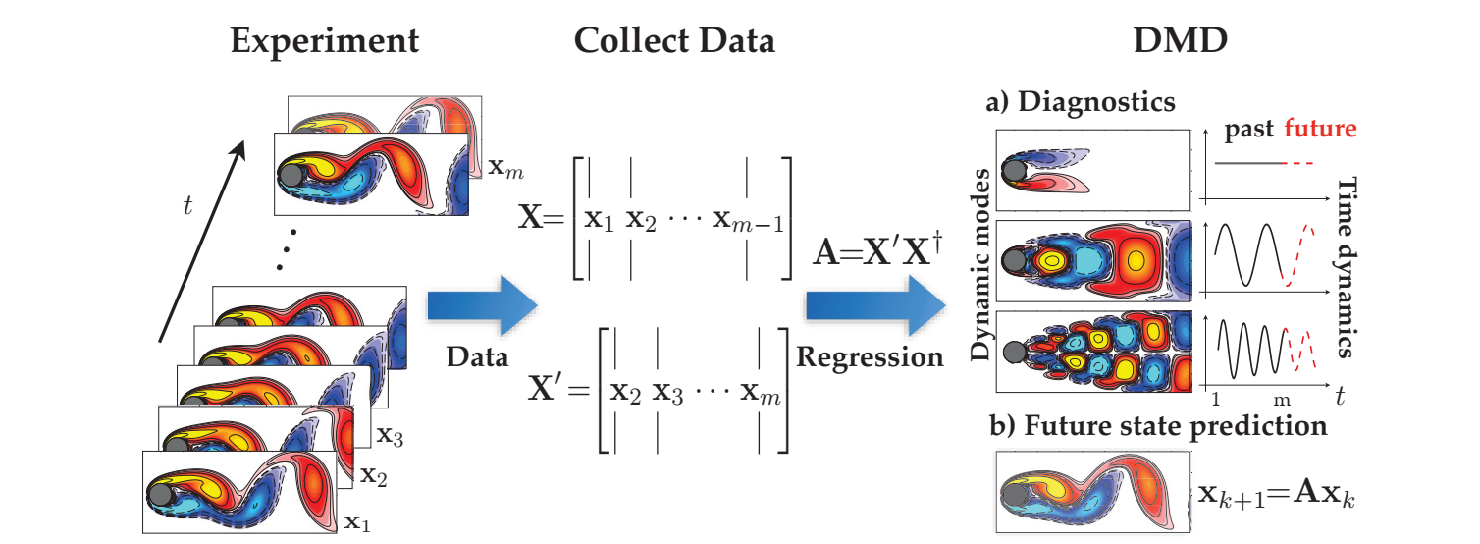
Method: Dynamic Mode Decomposition
Collect data at the end of each span
Stack this data in a large matrix X
Use this matrix and its shifted copy X’ to predict the linearized evolution operator A between the spans
The learned linearized operator will be used to compensate fiber propagation effects along the line
Required knowledge:
Linear algebra – 25 %
Fiber optics – 50%
Numerical simulations – 25 %
References:
[1] J.N. Katz et.al. , “Dynamic Mode Decomposition”, SIAM (2016).
[2] P. J. Schmidt , “Dynamic mode decomposition of numerical and experimental data”, J. Fluid Mech. 656, 5 (2010).
[3] J. H. Tu et. al., “On dynamic mode decomposition: Theory and applications”, J. Comput. Dyn. 1, 391 (2014).

Slide 6
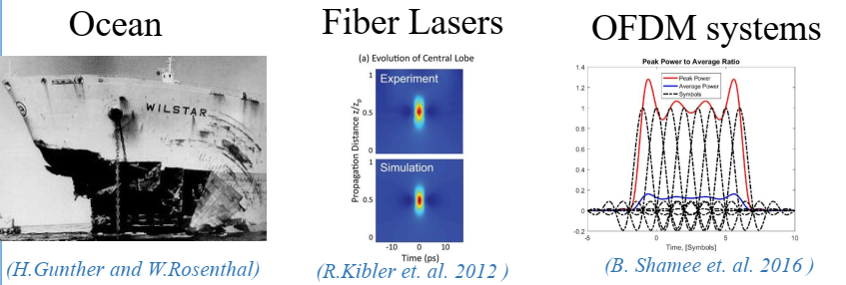
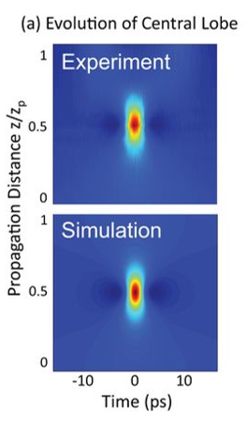
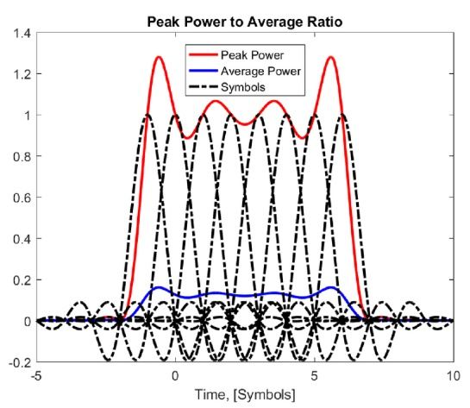
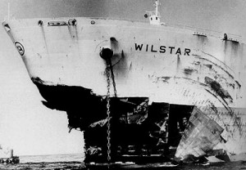
s-2024-085 Level: Medium Area: Digital communications, fiber optics, optimization methods Identifying dangerous phase sequences leading to high power outages in optical fiber communications
Freak wave: An event of high magnitude without an apparent precursor. Appears out of nowhere and disappears without a trace.
FWs occur when a large number of waves or pulses overlap at a given position in space and time
They can also occur in the context of optical communication leading to high power levels and signal distortion
The goal: Find the pulse sequences in optical fibers leading to occurrence of FWs
Fiber Lasers
Ocean
Fiber Lasers
Ocean
OFDM systems
OFDM systems

Slide 7
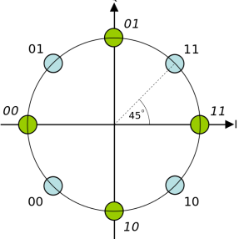
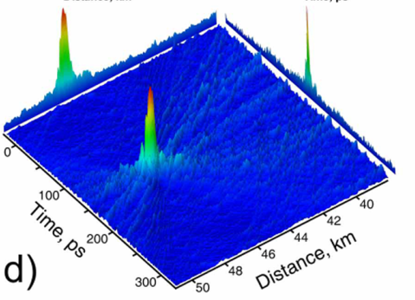
Method: Optimizing the output of the NLSE
NSE is the pain model for pulse propagation in optical fibers
At the transmitter we send a modulated sequence of pulses:
Each complex symbol is drawn from a modulation constellation (we shall choose M-PSK)
We can optimize the individual phases to maximize the intensity at a given point:
Required knowledge:
Digital communications – 25%
Fiber optics -25%
Optimization methods – 50 %
References:
[1] S. Derevyanko et. al. “Visualisation of extreme value events in optical communications”, APL Photonics 3, 060801 (2018).

Slide 8
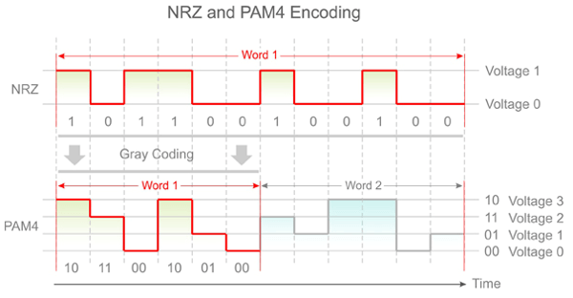
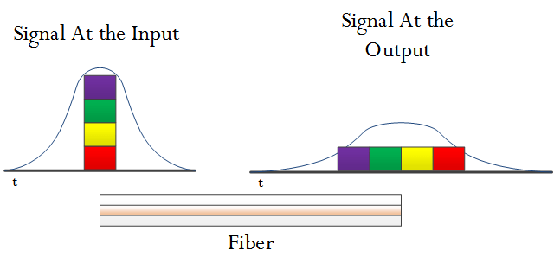
s-2024-086 Level: Medium Area: Fiber optics, optical imaging, iterative algorithms Dispersion compensation in intensity modulation direct detection optical fiber system
Short-reach transmission systems (<150 km) traditionally utilize intensity modulation (IM) at the transmitter and direct detection (DD)
Usually 1-bit OOK or 2-bit 4-PAM modulation is used
Unfortunately chromatic fiber dispersion (CD) broadens the pulses and leads to signal distortion.
The transfer function of CD is known but its complex so we cannot use it directly with IM-DD systems!
The goal: Pre-design the input pulse shape to precompensate the effects of dispersion at Tx without using

Slide 9
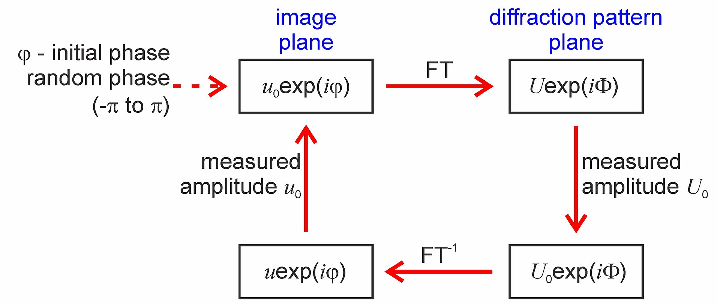
Method: Gerchberg-Saxton Algorithm
Initially used in Fourier optics to retrieve phase information from the measurement of the amplitude of a signal and its Fourier transform
Can be adopted to design the real wave-form at Tx so that at the Rx the signal shape is the desired OOK or 4-PAM sequence
In the project we shall take into account signal attenuation and phase noise at Rx.
References:
[1] A.S. Karar et. al., “Recent Advances in Coherent Optical Communications for
Short-Reach: Phase Retrieval Methods”, Photonics 10, 308 (2023).
[2] A.S. Karar, “Iterative Algorithm for Electronic Dispersion Compensation in IM/DD Systems ”, J. Lightwave Technol. 38, 698 (2020).
[3] D. Zou et. al. “Modified Gerchberg-Saxton Algorithm Based Electrical Dispersion Pre-Compensation for Intensity-modulation and Direct-detection Systems ”, J. Lightwave Technol. 40, 2840 (2022).
[4] G. Agrawal, “The Nonlinear Fiber Optics”, Academic Press, 2013.
.
Required knowledge:
Digital communications – 50%
Fiber optics-30%
Numerical simulation – 20 %

